Slide 1
SMART WASTE BIN MONITORING SYSTEM
……A WAY TO KEEP YOUR CITY CLEAN

Slide 2

RCC INSTITUTE OF INFORMATION TECHNOLOGY, KOLKATA
TEAM MEMBERS:
ARNAB BISWAS- ECE
SOMNATH PAL- ECE

Slide 3
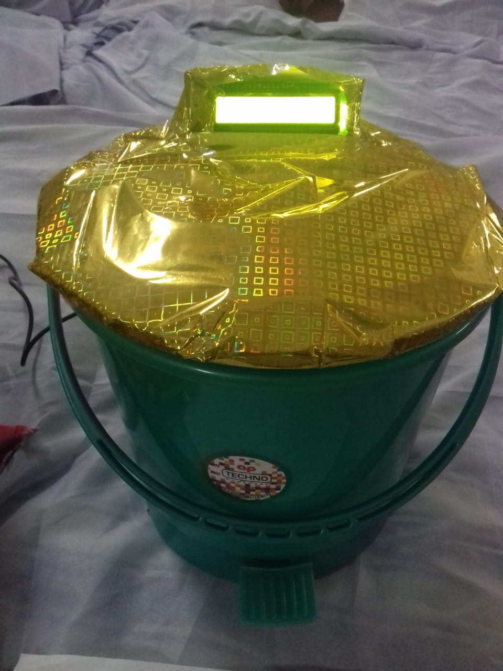
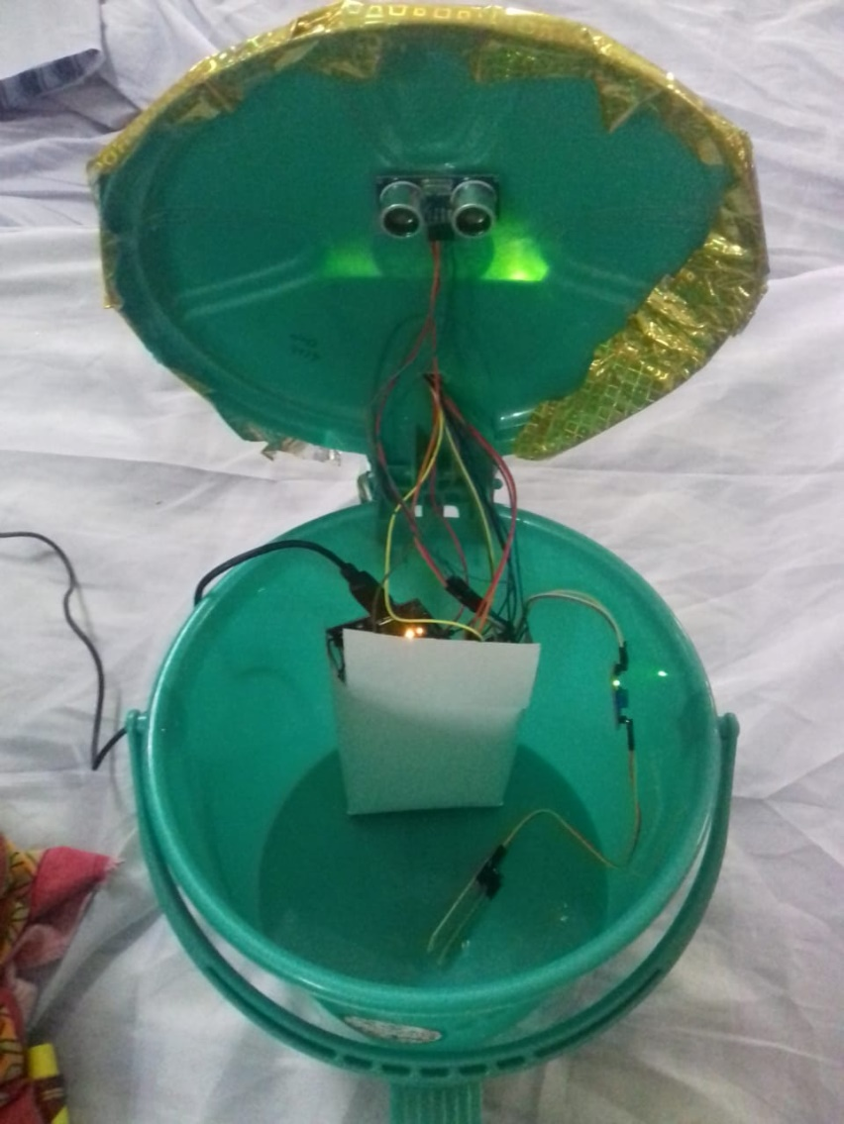
PROJECT MODEL PIC

Slide 4
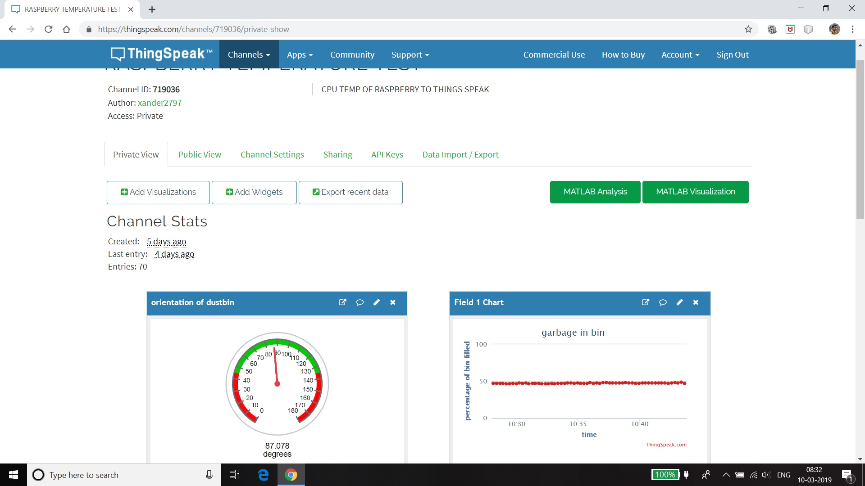

Slide 5
NEEDS OF THE PROJECT
A alert can be arranged when a garbage is full so as to schedule a garbage cleaning.
If the percentage is very high for a long period of time then alert for cleaning it can be arranged.
If garbage can is lying on the ground sideways then a alert will announce to clean the surrounding areas.
In short it is a controlled way of managing garbage in a city.

Slide 6
HARDWARE USED
ARDUINO UNO R3
TEMPERATURE SENSOR(LM35)
SOIL MOISTURE SENSOR
GYROSCOPE AND 3-AXIS ACCELEROMETER (GY521 MPU6050)
LCD
BLUETOOTH MODULE(HC-05)
RASPBERRY PI ZERO-W
ULTRASONIC SENSOR(HC-SR04)
TEMPERATURE AND HUMIDITY SENSOR (DHT11)
BATTERY(OPTIONAL SOURCE)

Slide 7
BENEFIT & ADVANTAGES:
It keeps our surroundings clean and green and free from bad odour of wastes, emphasizes on healthy environment and keep cities more beautiful.
It further reduces manpower requirements to handle the garbage collection process.
Applying smart waste management process to the city optimizes management, resources and costs which makes it a "smart city".
It helps administration to generate extra revenue by advertisements on smart devices.

Slide 8


